Slide 1
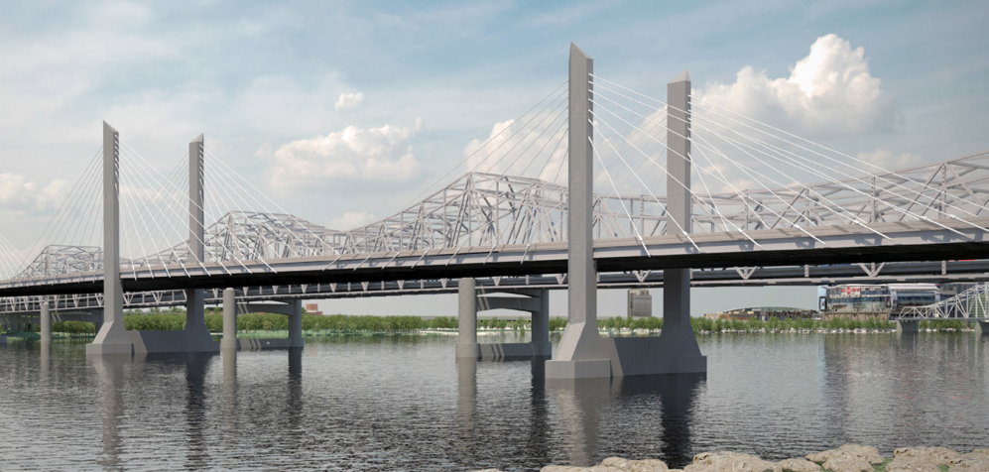
Ohio River Bridges Project Downtown Crossing Construction Update
Jeremiah Littleton, PE – KYTC
Kenny Pietz, PE – HDR
September 9, 2015

Slide 2
Brief History
1969
Project placed in long range plan
Fall 2012
KYTC & IFA/INDOT Announce Results
Downtown Crossing – D/B Contract
KYTC selects Walsh Construction DBT Bid = $860 Million and Dec. 9, 2016 Substantial Completion
Dec. 28, 2012
Notice to Proceed

Slide 3
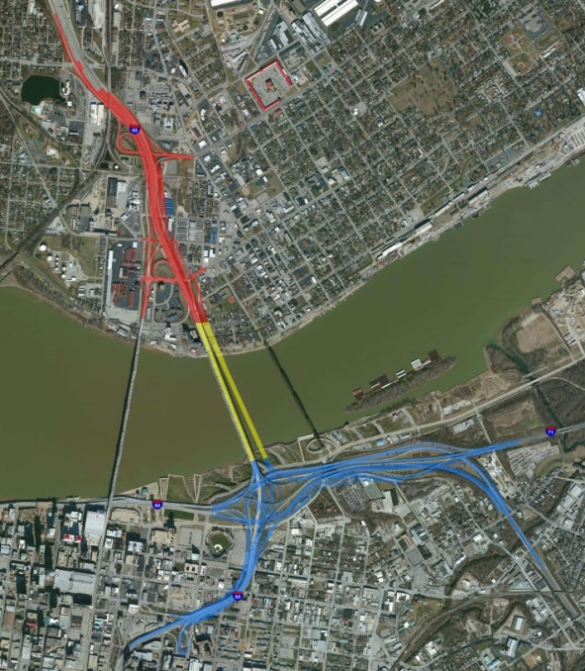
Downtown Crossing
Three components:
New cable-stayed bridge
Improved Kennedy Bridge
New interstate connections
Ground breaking in June 2013
Construction started in earnest in July 2013
Over 750 workers, including subcontractors

Slide 4
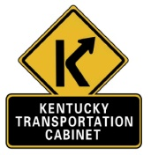
KYTC Enlists Help with Construction Oversight
Oversight Assistance Consultants

Slide 5
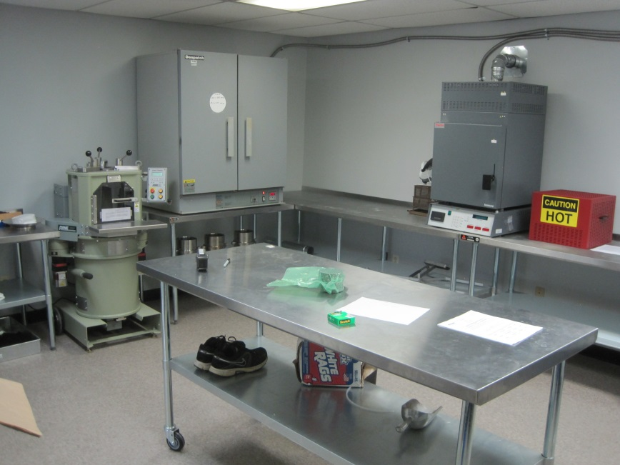
Positives of Consultants on the Project
Technical Expertise and Cable Stayed Bridge Experience
Staffing Flexibility and Adjust to Changes in Work Load
Ability to Quickly Establish an Onsite Material Testing Lab
Understood Role as Support to KYTC, who’s Managing the Project

Slide 6
Oversight Assistance Consultants
– Prime Consultant
Subconsultants:
Greenman-Pedersen, Inc.
FIGG Bridge Inspection, Inc.
Parsons, Cunningham & Shartle Engineers, Inc. (DBE)
Redwing Ecological Services, Inc. (DBE)
S&ME, Inc.
American Engineers, Inc.
Thelen Associates, Inc.
KHAFRA (DBE)

Slide 7
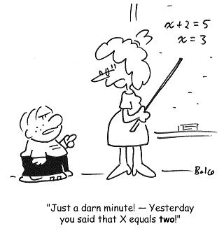
Fast Pace, High Volume of Work
Simple math really.
$860 million of work in 42 months = >$20 Million of work per month
Peak months have exceeded $30 million!

Slide 9
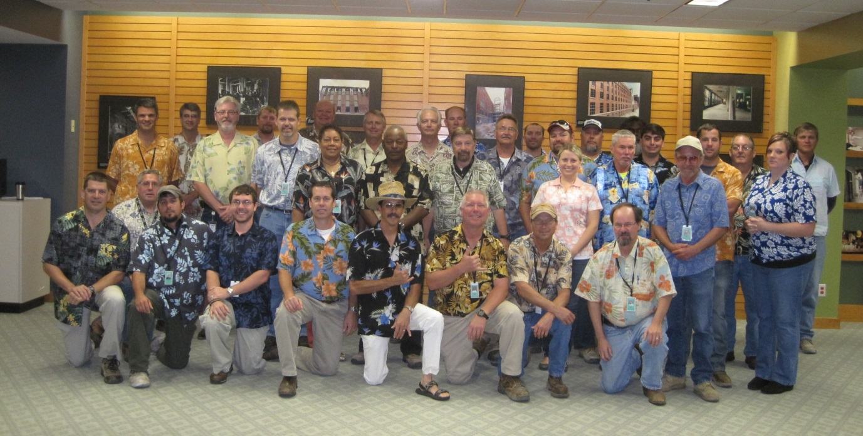
Oversight Assistance Consultant Team

Slide 10
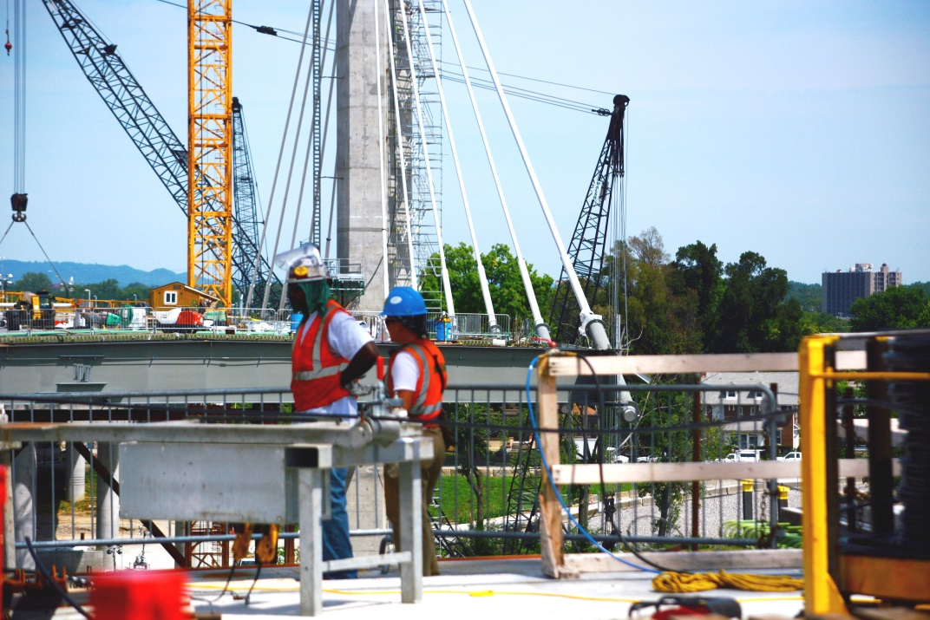
Downtown Crossing By The Numbers
More than 60 overpasses and bridges
More than 60 retaining walls
More than 440,000 tons of asphalt
1.3 million cubic yards of soil being moved
New bridge is 2,100 feet long

Slide 11
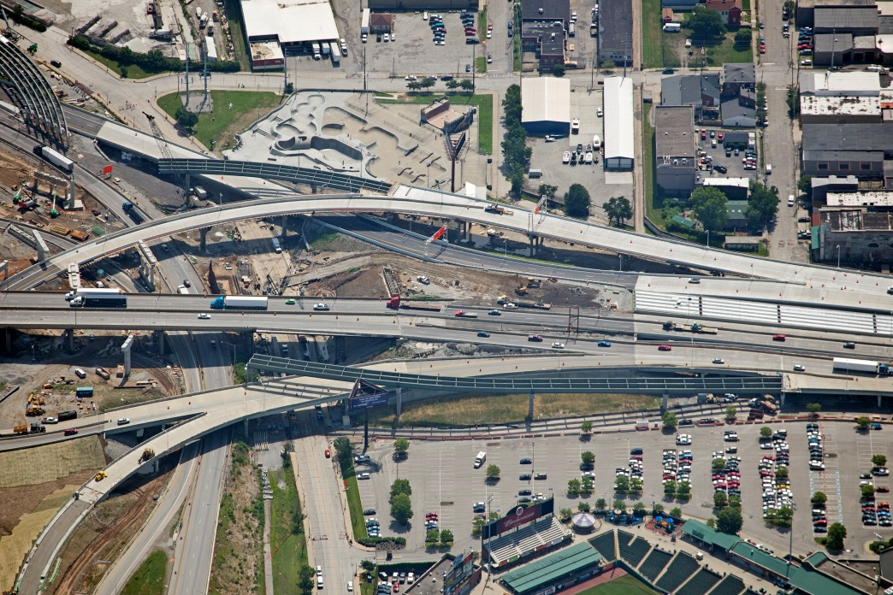
Section 1: KY Approach
Kennedy Interchange is being reconfigured eliminating the weaves of “Spaghetti Junction”
More than 40 new ramps and overpasses are being built on the Kentucky side
Several new ramps have already opened to traffic

Slide 12
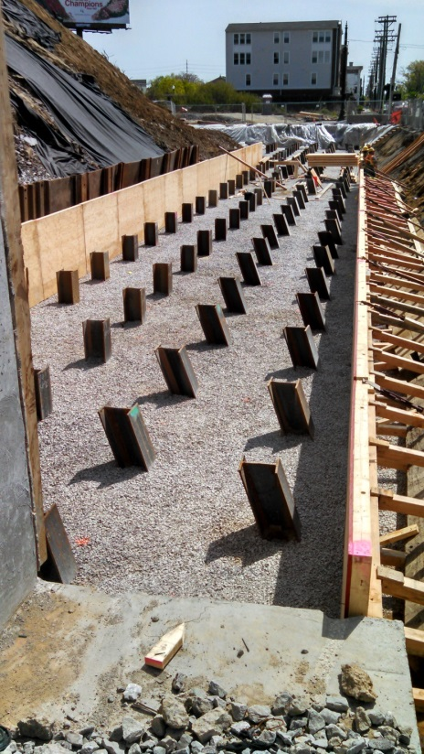
Section 1 Numbers
21.5 million lbs. of structural steel
Over 100,000 cu.yds. of concrete
25.0 million lbs of re-steel
Nearly 32,000 L.ft. of precast girders
154 setups for deck finishing machine
Driven over 385,000’ of the 481,000’ (91 miles) of piling

Slide 13
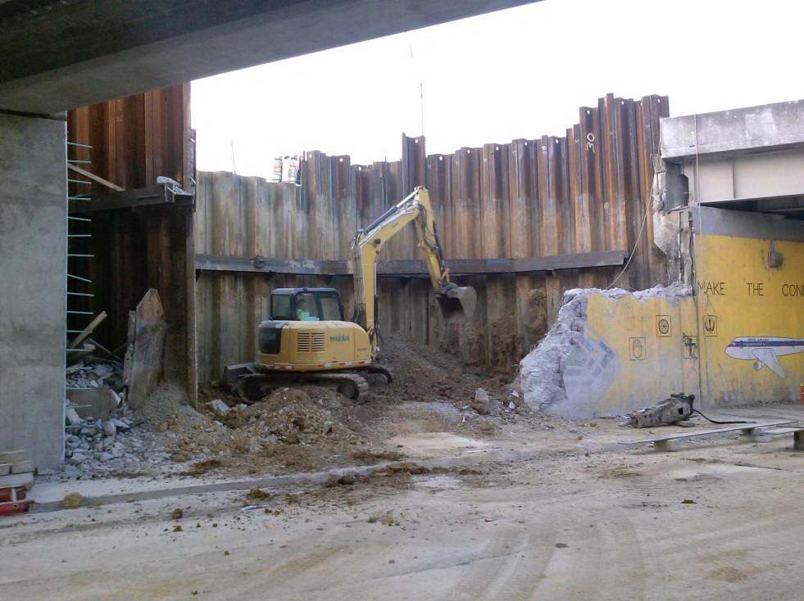
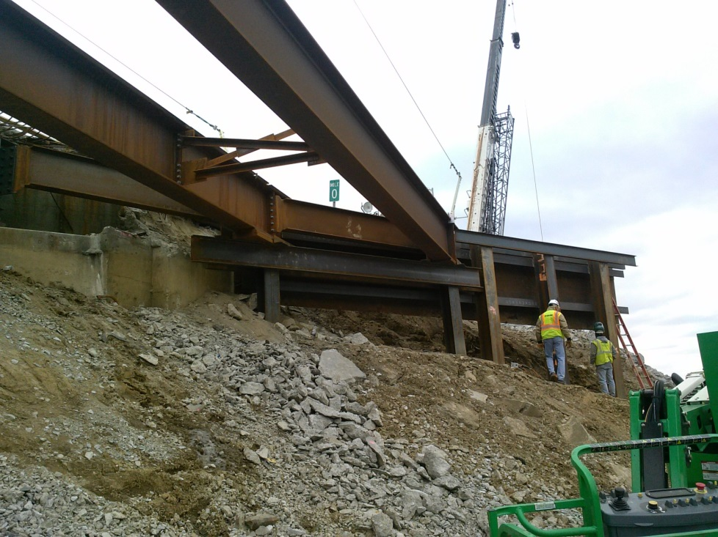
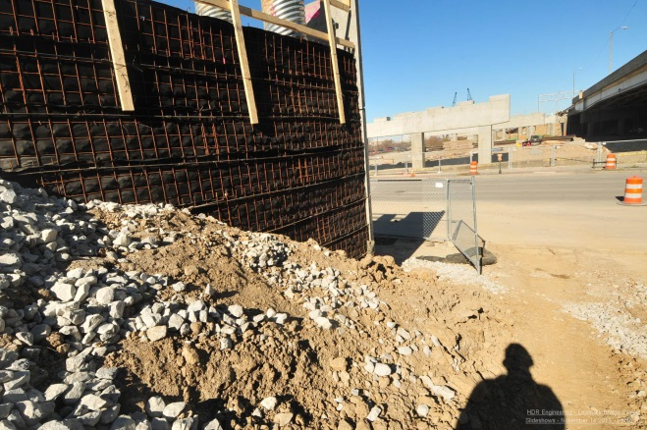
Maintaining Traffic = Phased Construction

Slide 14
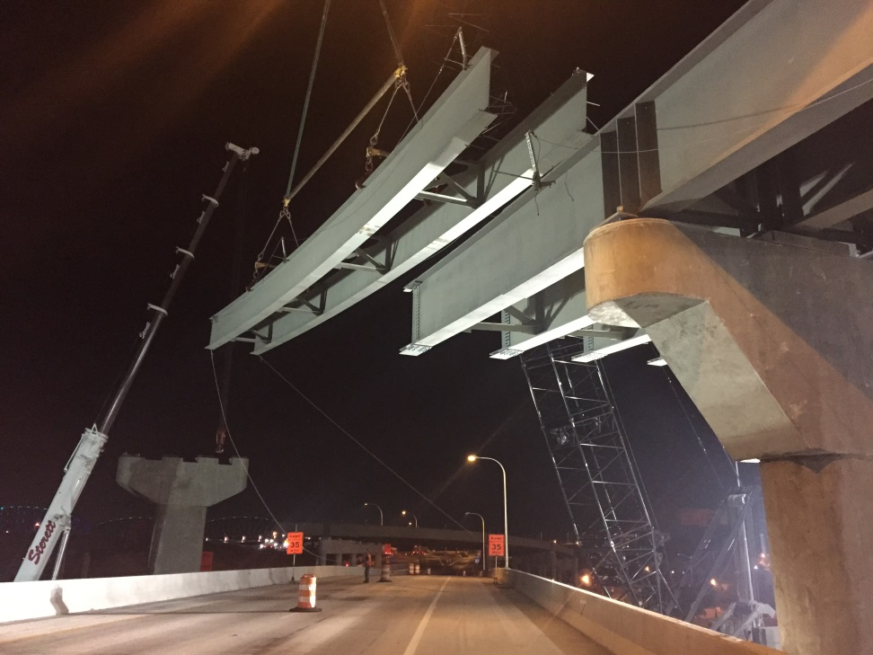
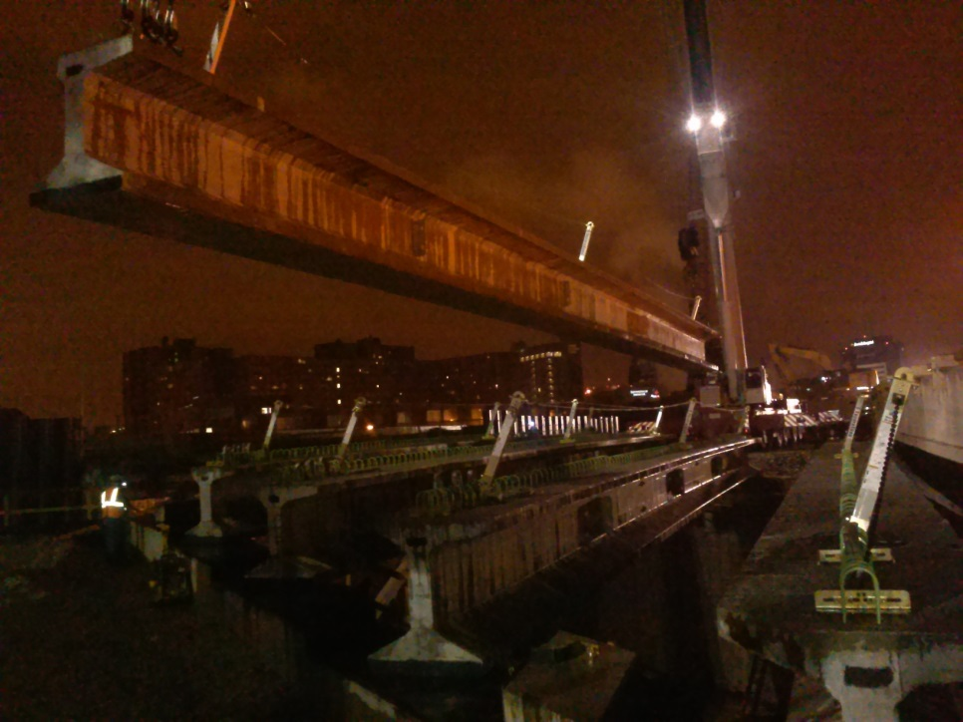
Maintaining Traffic = Night Work

Slide 15
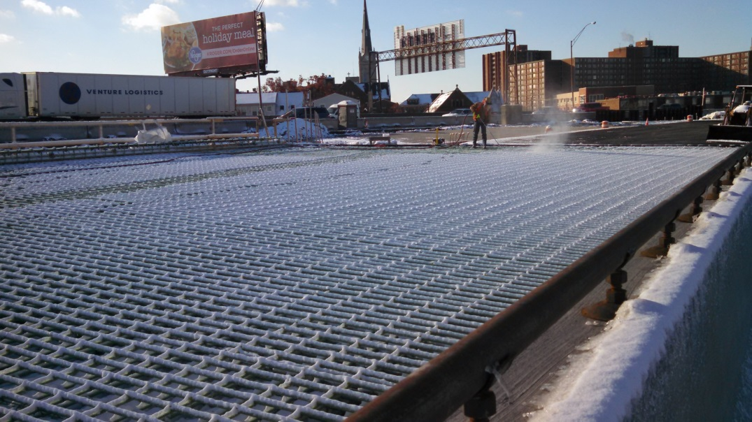
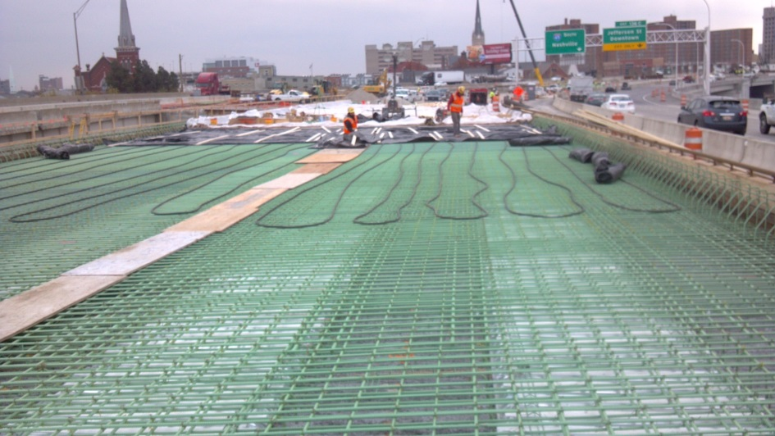
Pace Meant Working through the Winter

Slide 16
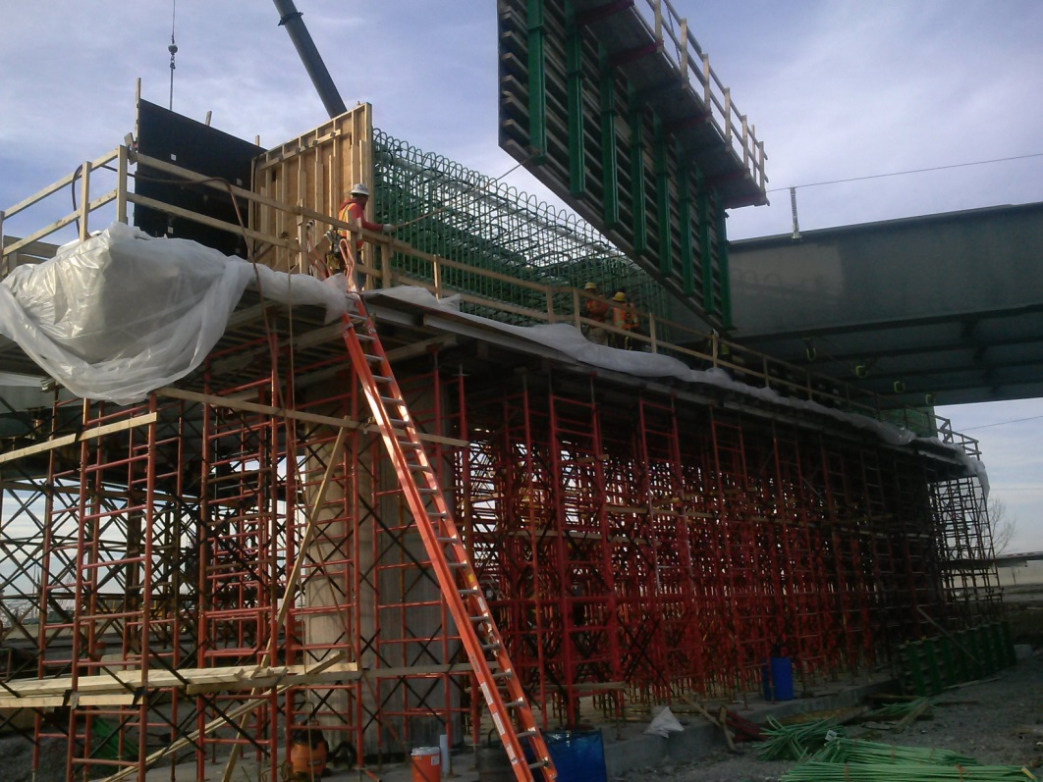
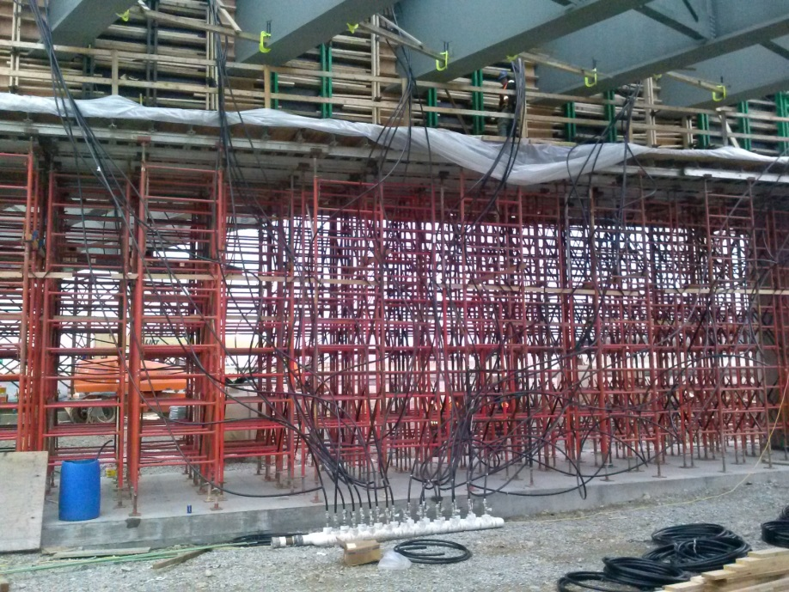
Technical Challenges - Straddle Bent

Slide 17
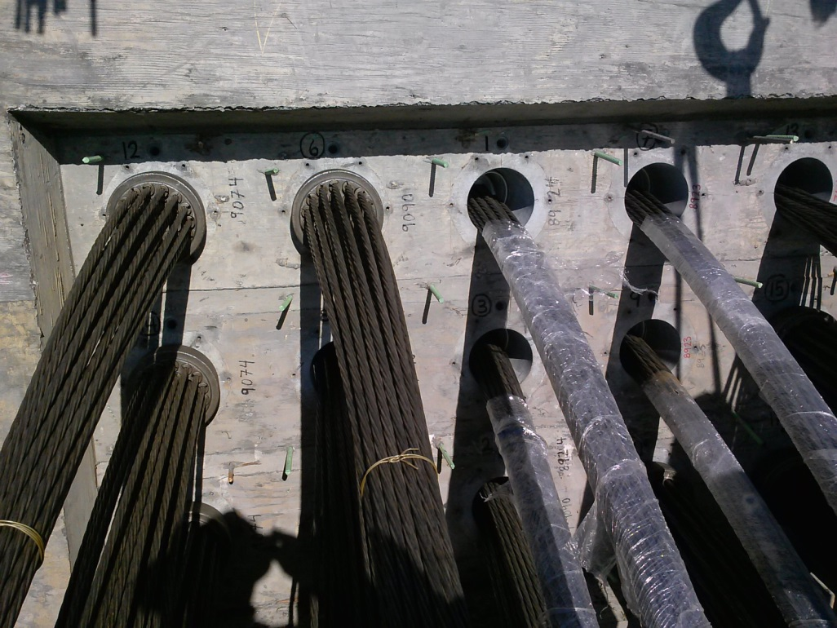
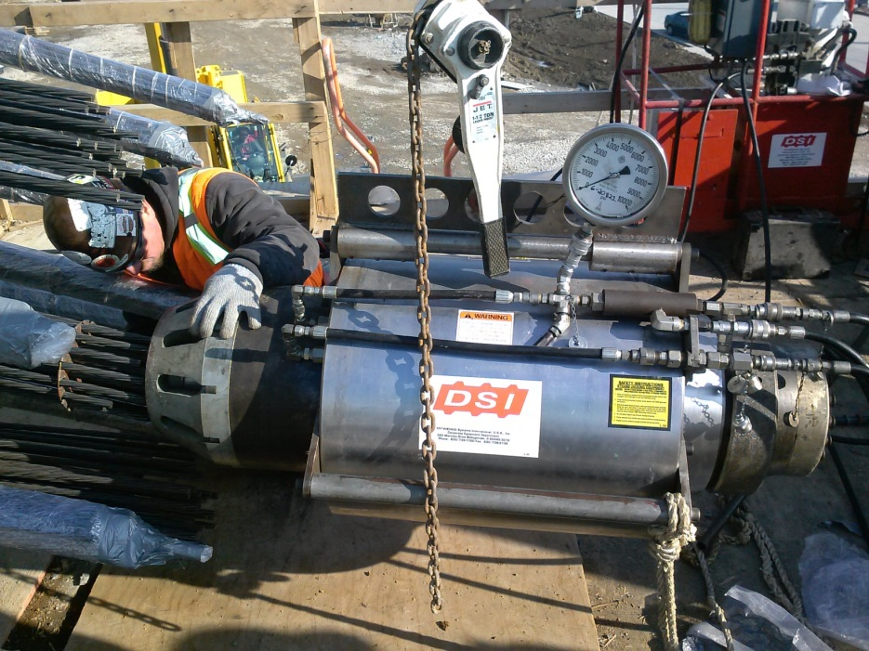
Straddle Bent Post-Tensioning (PT)

Slide 18
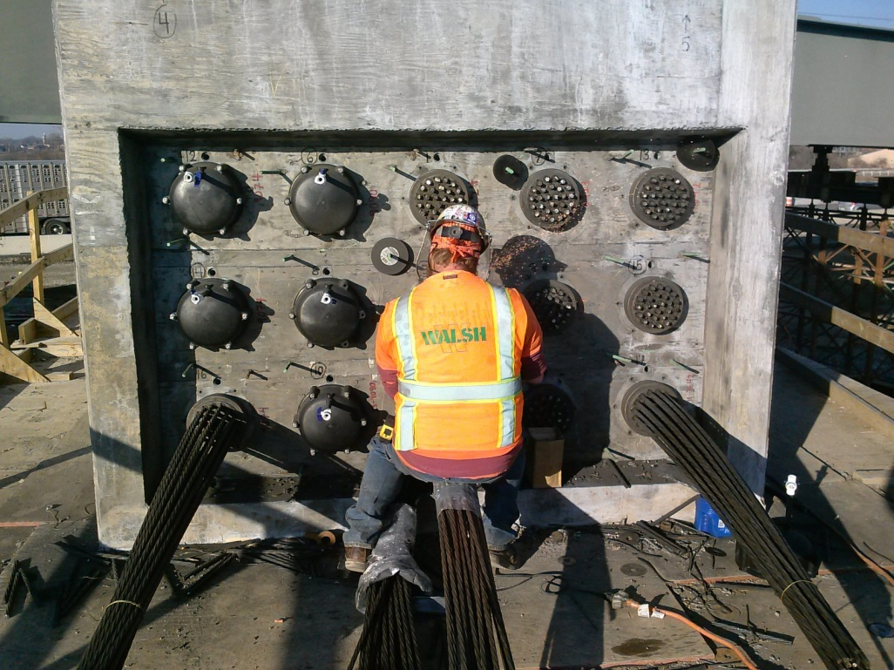
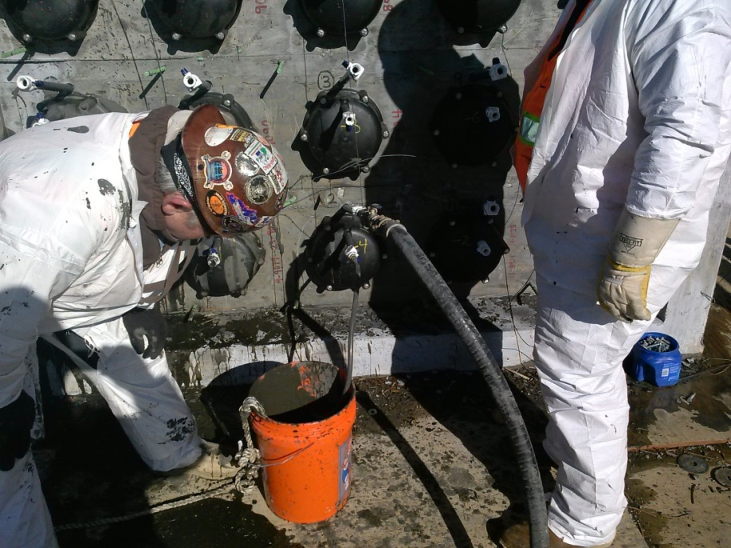
Straddle Bent PT Capping and Grouting

Slide 19
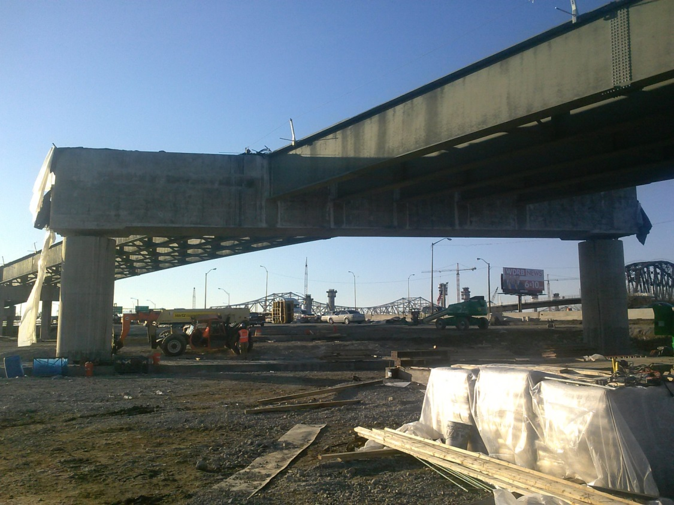
Completed Straddle Bent

Slide 20
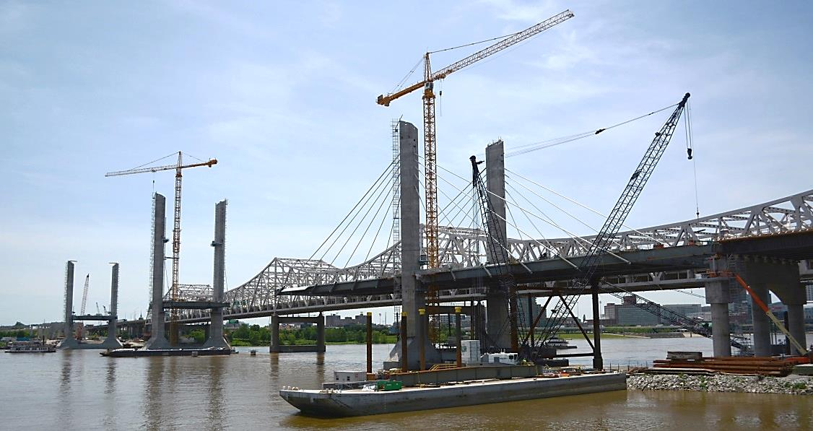
Section 2: New I-65 Bridge
All three towers reached their finished heights in June
Tower 3: 230 feet
Tower 4: 280 feet
Tower 5: 230 feet
Currently erecting structural steel, setting precast deck panels, and installing and stressing stay cables
Deck will be completed this fall
New bridge to open to two-way traffic by January

Slide 21
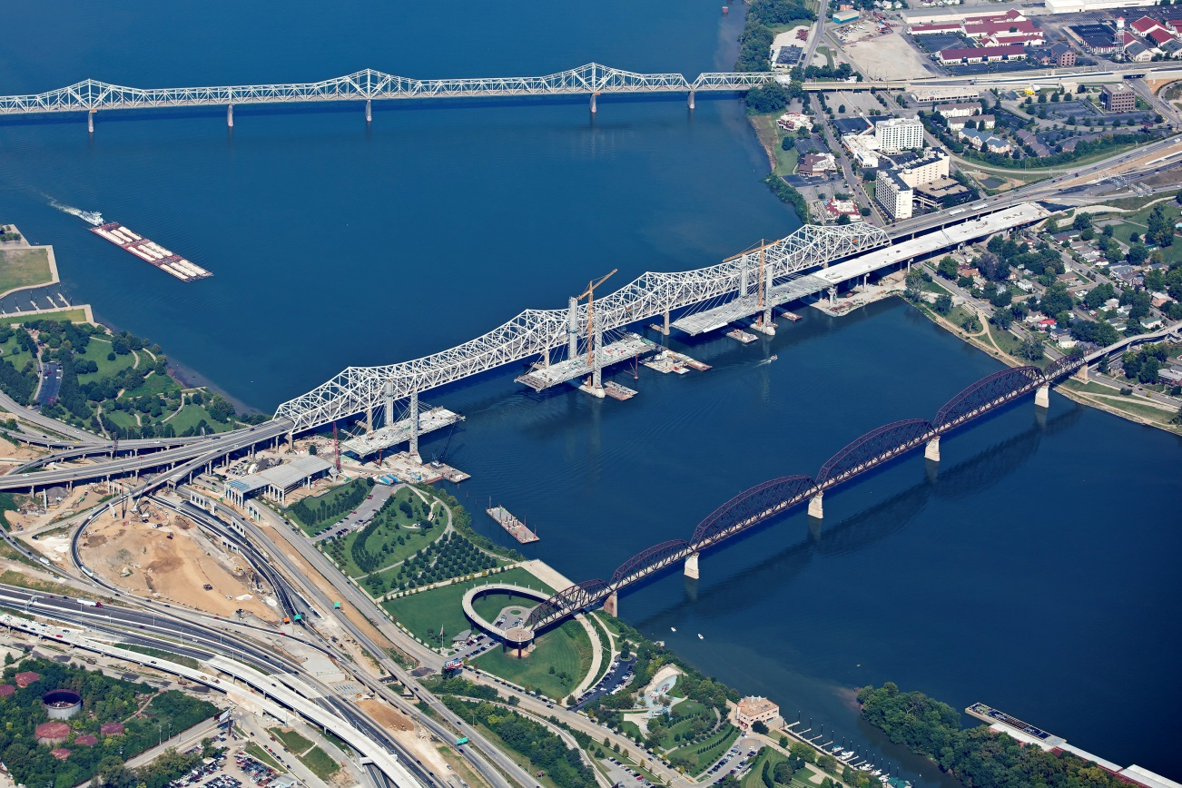
Cable Stayed Bridge Construction (after towers)

Slide 22
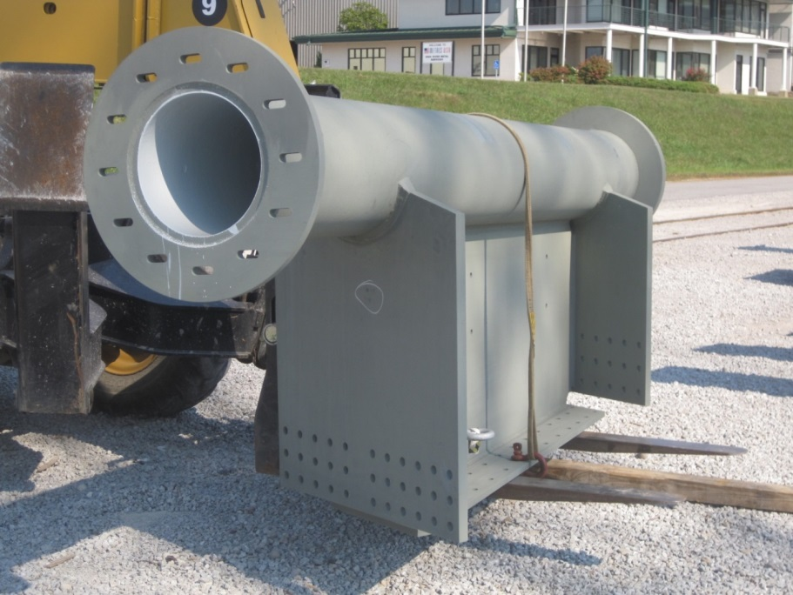
Erecting Pre-assembled Segments

Slide 23
Welding HDPE Stay Pipe Together

Slide 24
Installing Cable Stay Pipe and Master Strand

Slide 25
Master Strand and Stay Pipe Installed

Slide 26
Installing the Rest of the Cable Strands

Slide 27
Removing HDPE Sheathing Off Strand Ends

Slide 28
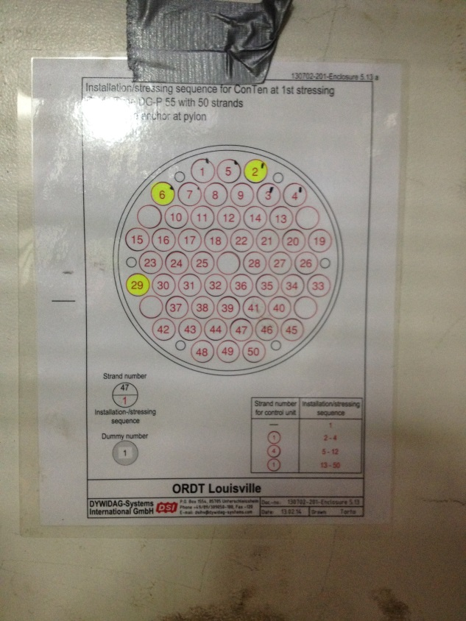
View of Cables and Anchors in Tube

Slide 29
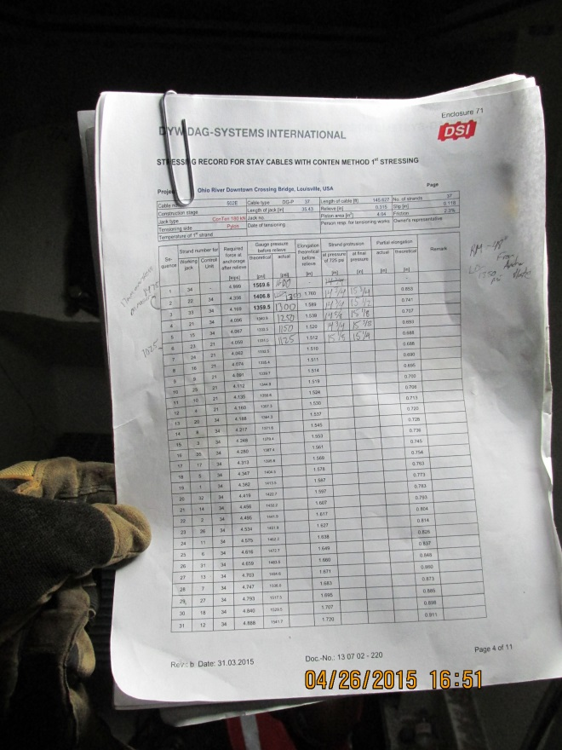
Stressing Cable Strand with Mono-strand Jack (Stage1A)

Slide 30
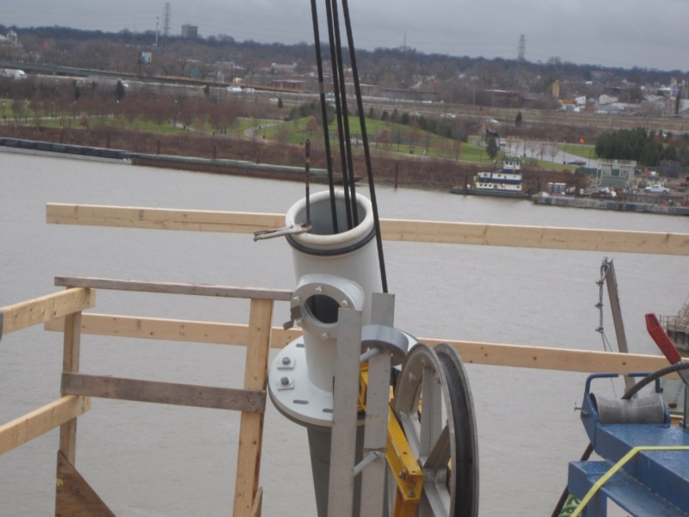
Strands Range from 36 & 103 per Cable

Slide 31
Installing Precast Deck Panels

Slide 32
Stressing to Stage 1B

Slide 33
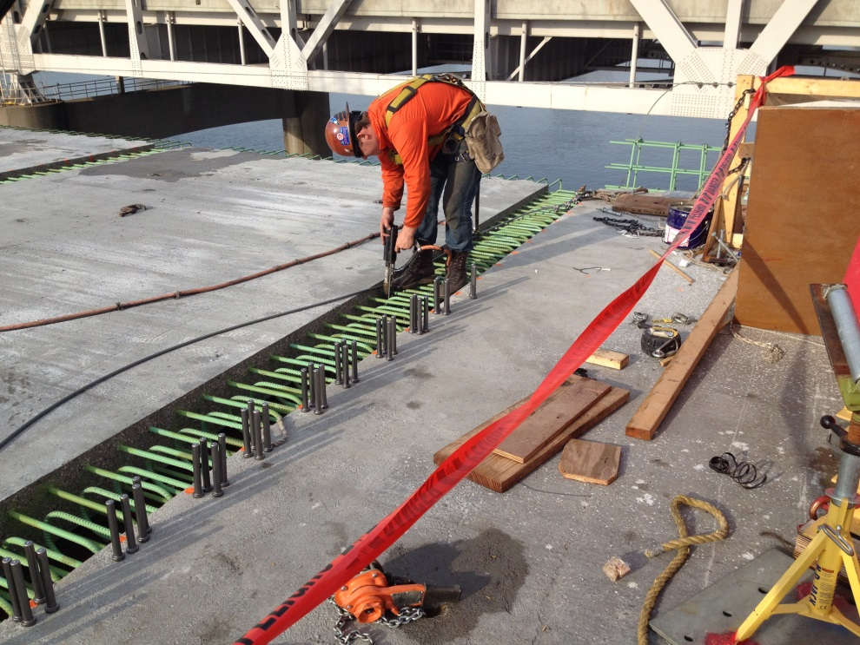
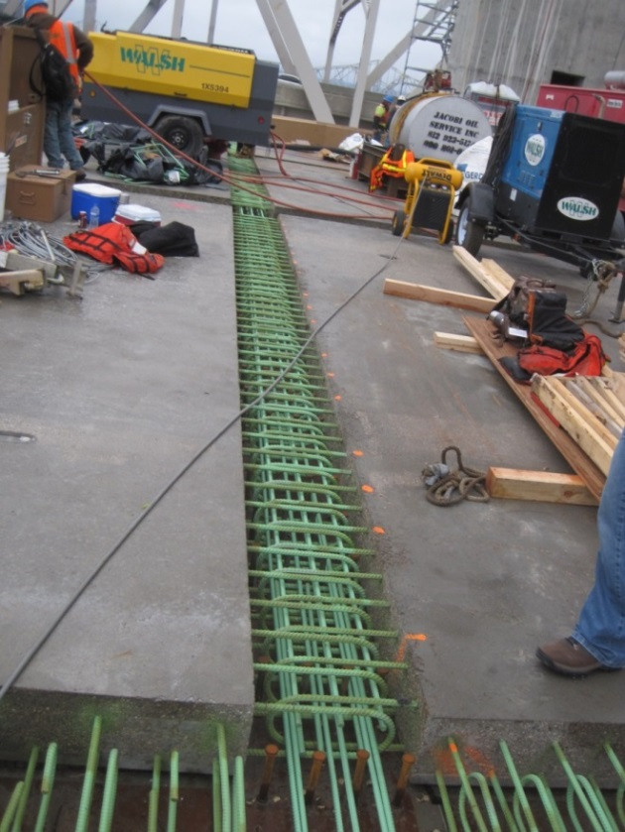
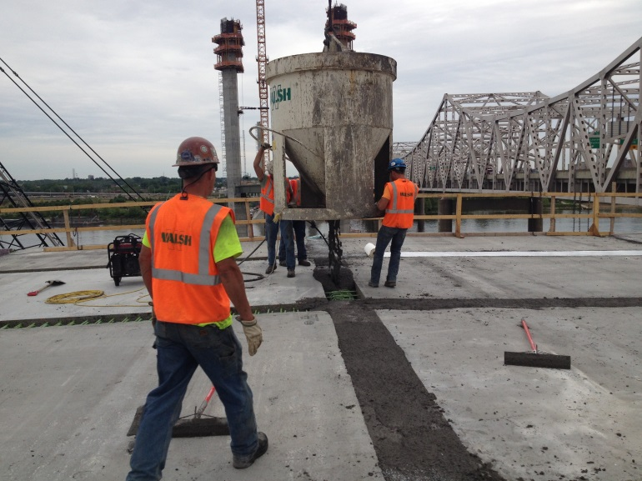
Adding Shear Studs and Rebar; then do Infill Pour

Slide 34
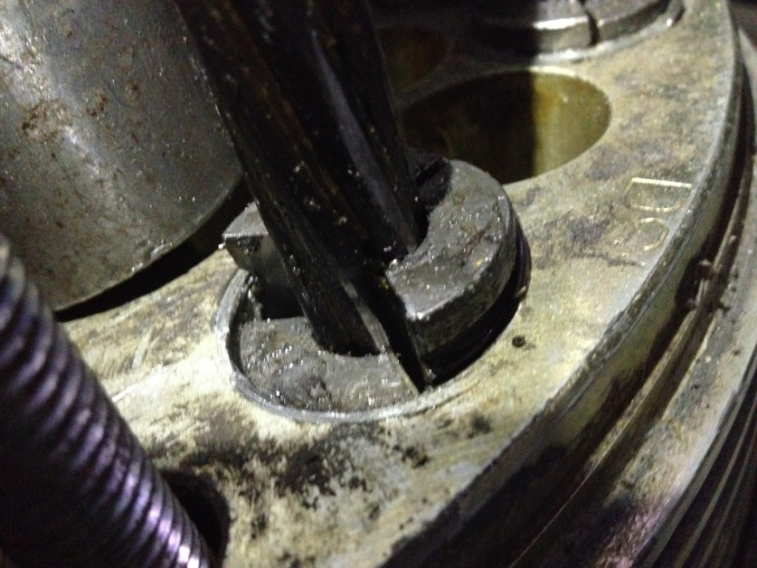
Final Stressing to Length

Slide 35
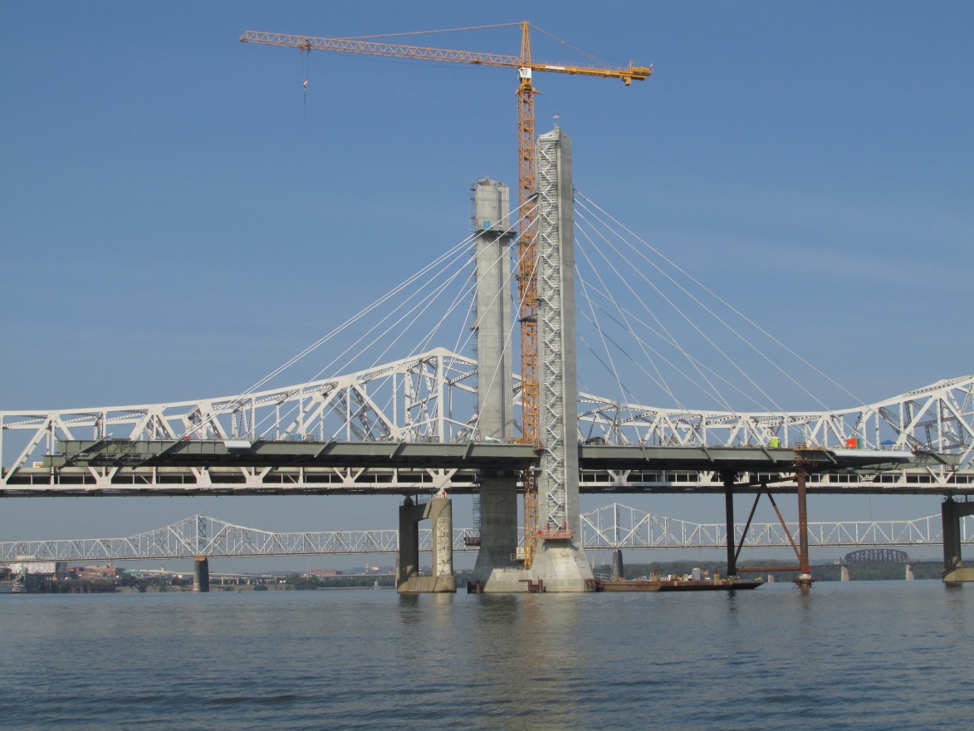
Balanced Cantilevered Construction

Slide 36
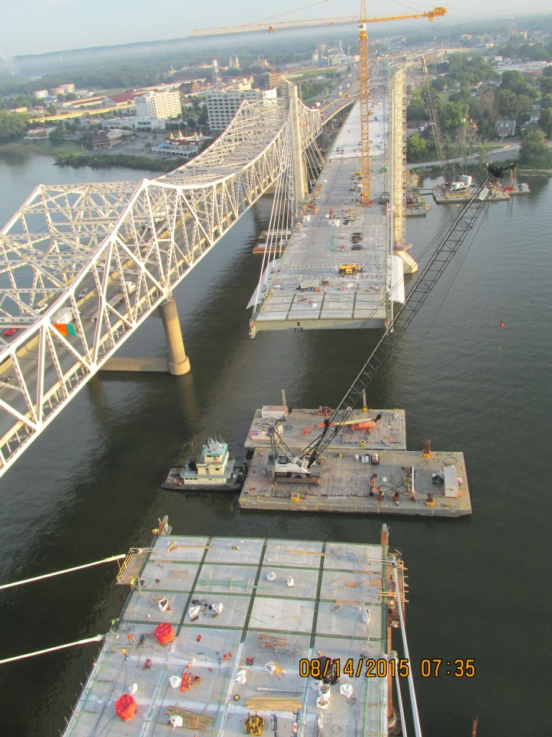
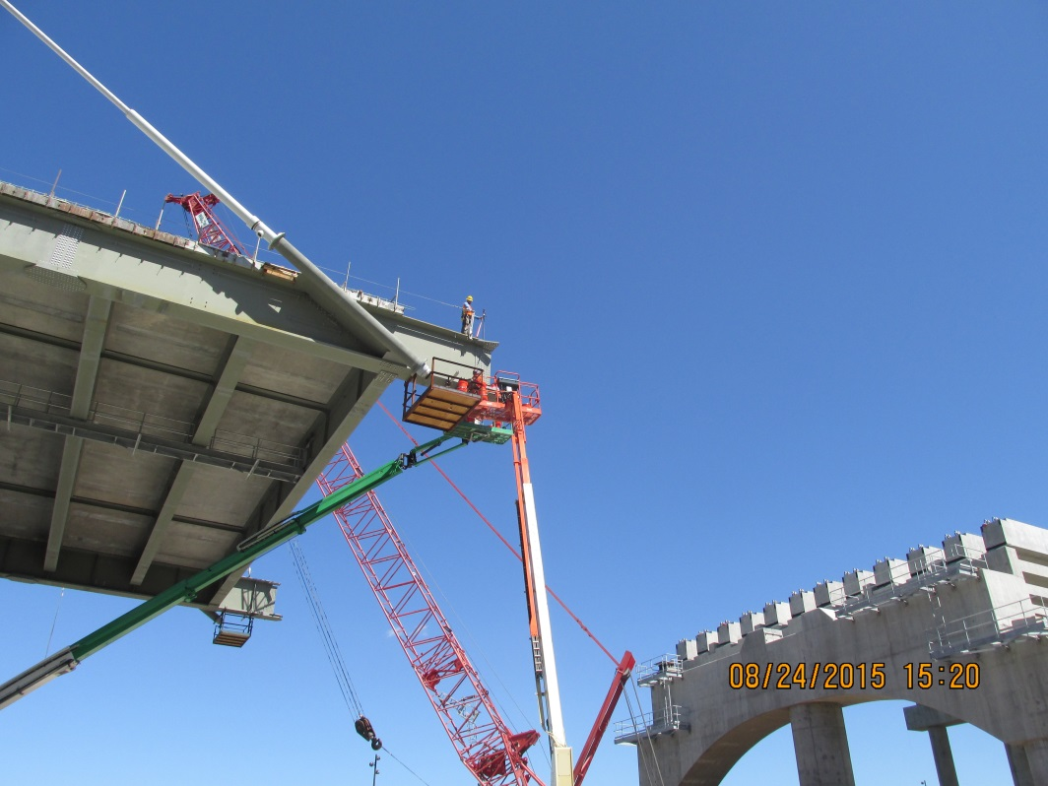
Survey and Geometry Control

Slide 37
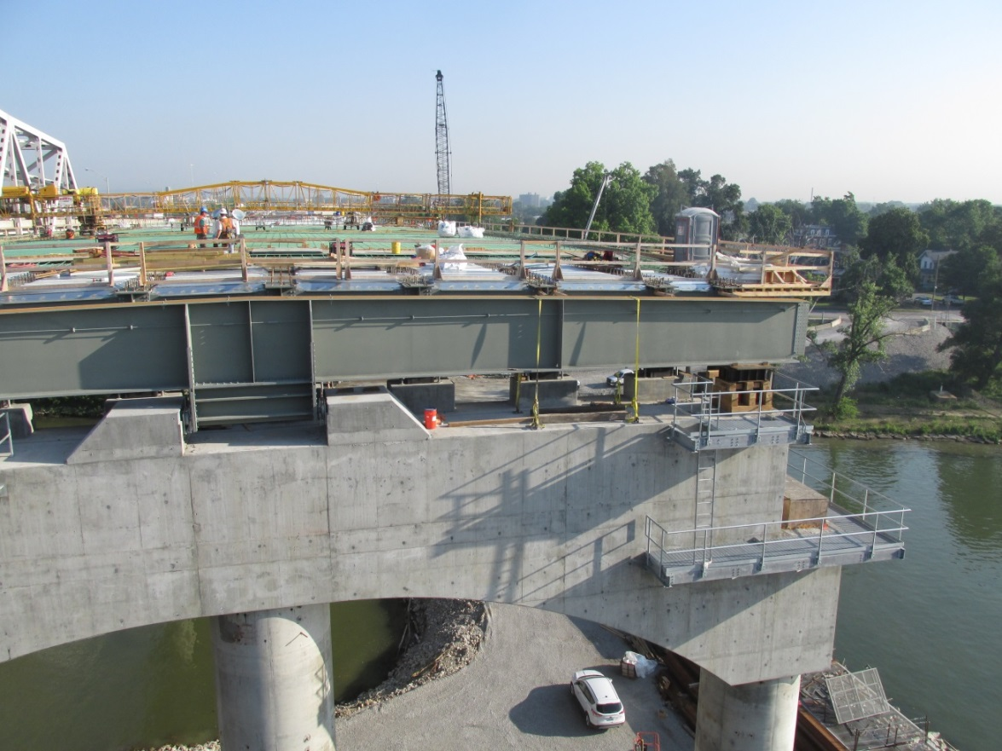
Anchor Pier 6 Floor Beam Installed

Slide 38
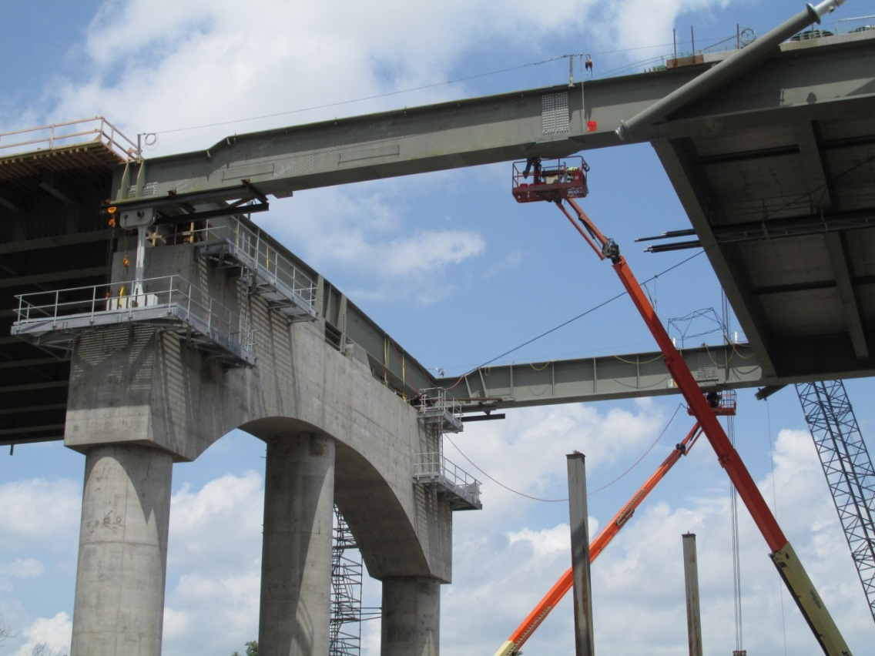
Landed on Anchor Pier and Doing Final Bolting

Slide 39
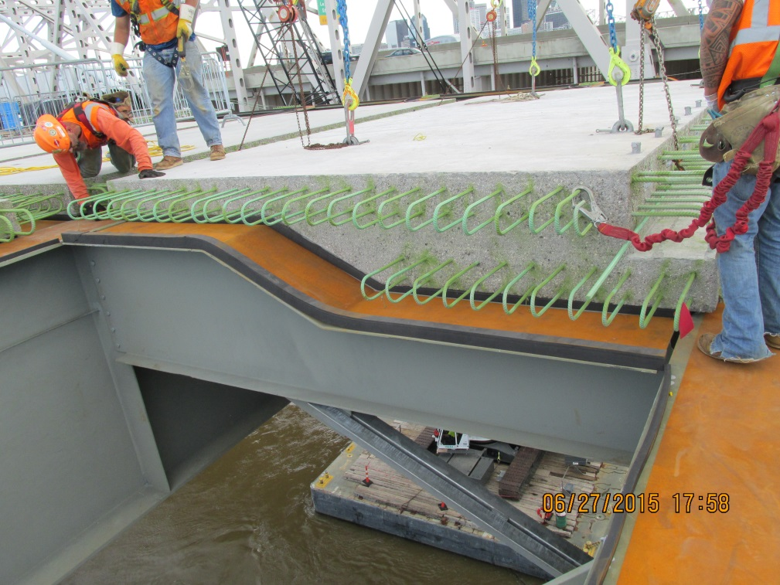
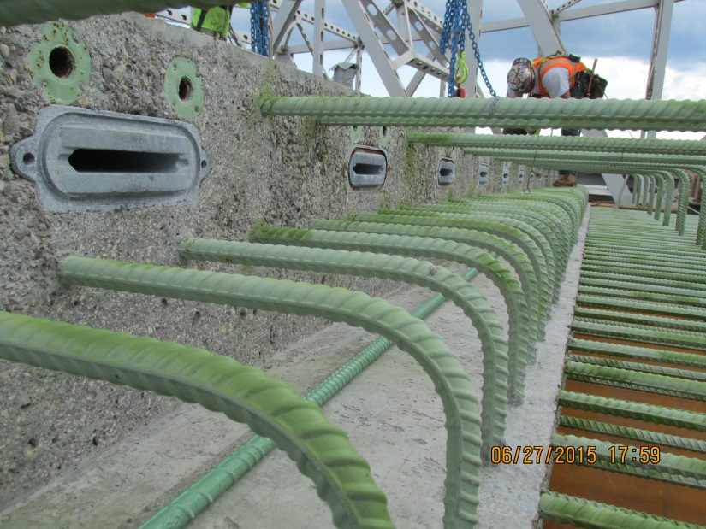
Installing Precast Panels at Anchor Pier

Slide 40
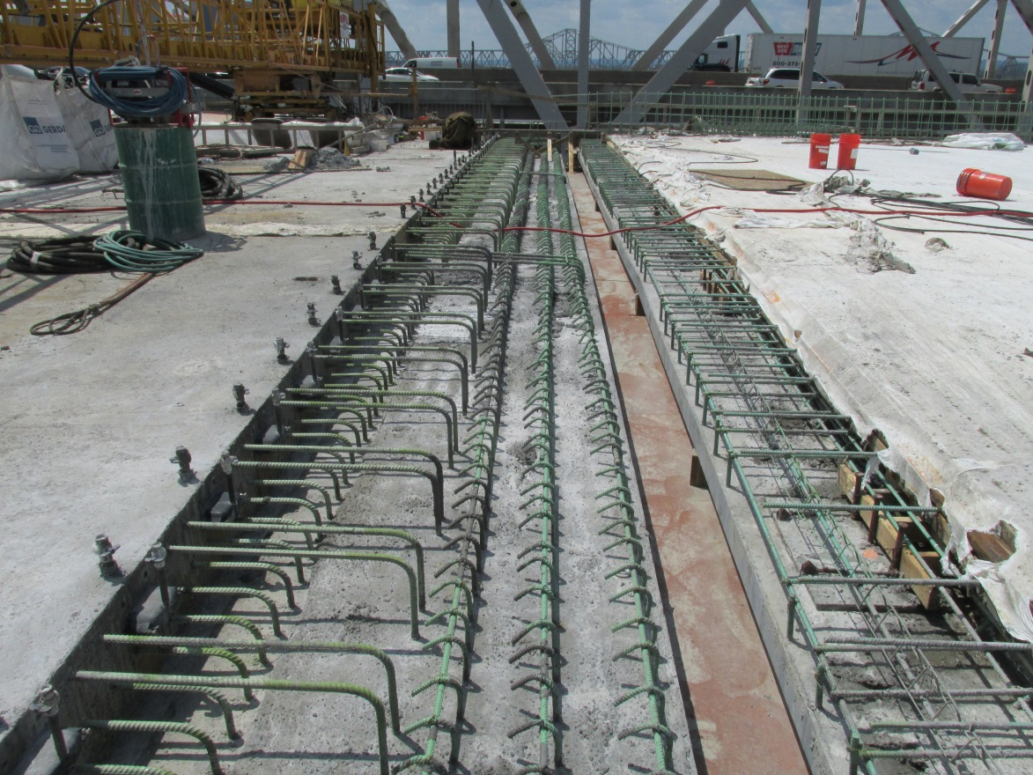
Preparations for Finger Joint

Slide 41
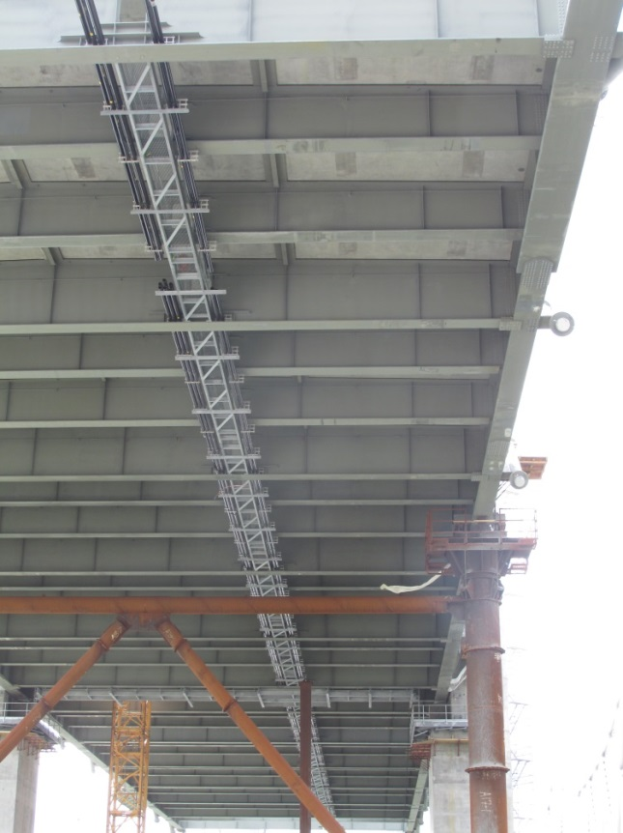
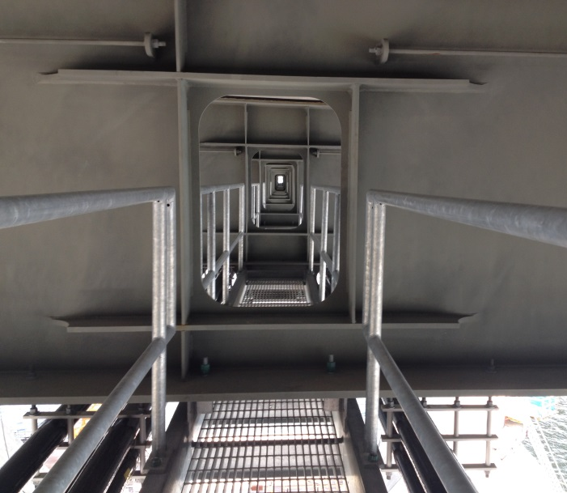
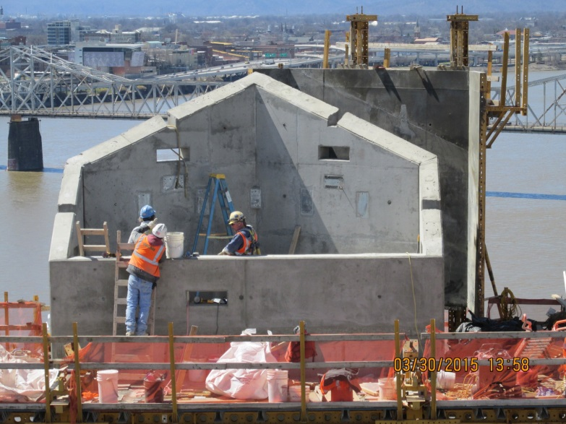
Future Inspection and Maintenance Access

Slide 42
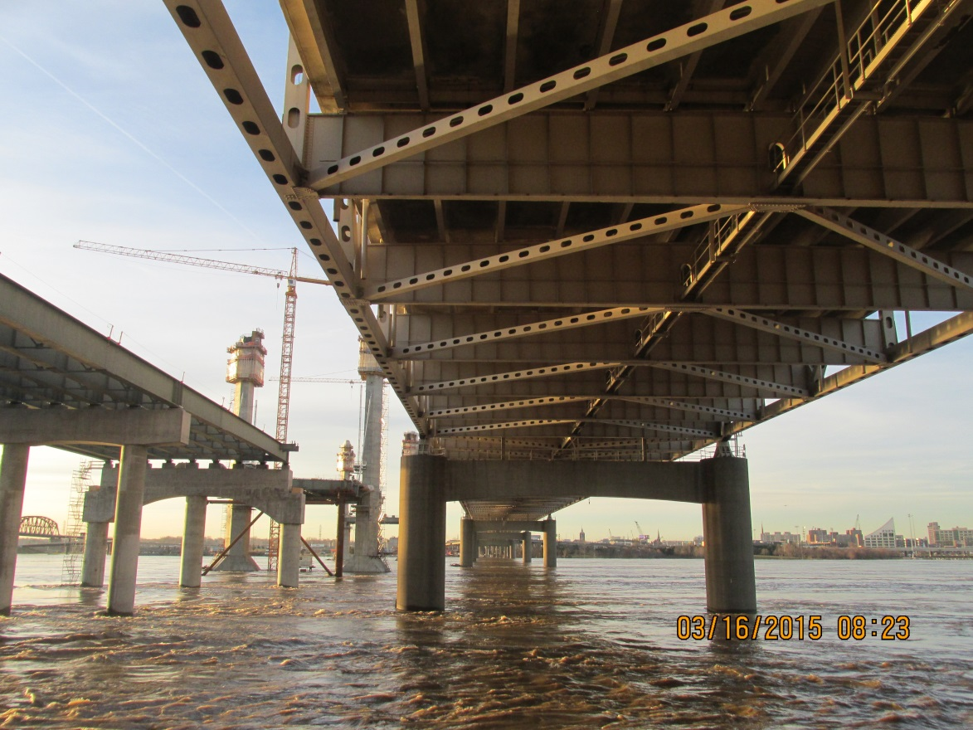
Challenges – High Water

Slide 43
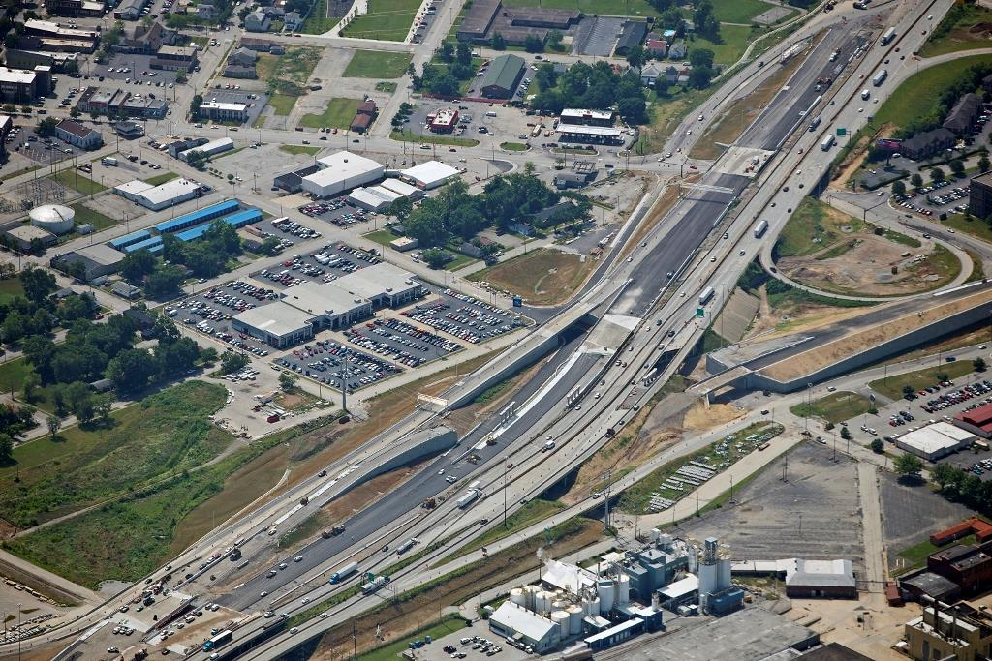
Section 3: IN Approach
I-65 North traffic shifted to new completed lanes of I-65 North
I-65 South traffic to shift over later this month
Indiana approach now connects to Tower 5
Flyover ramp from US 31 North to I-65 North to open late this year

Slide 44
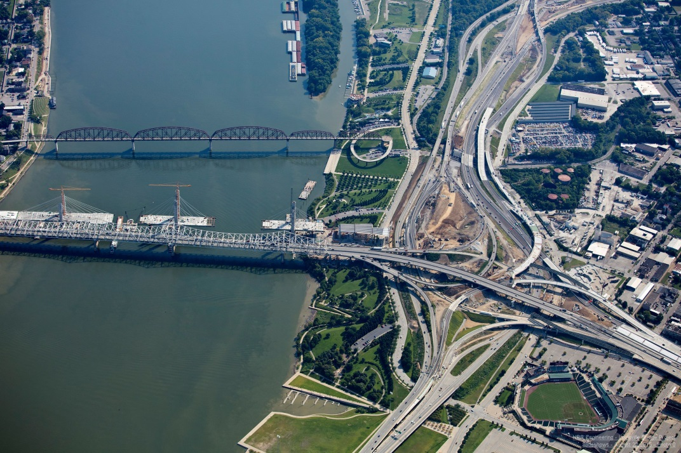
What to Expect
New cable-stayed bridge opens to two-way traffic in less than 4 months
Attention shifts to the Kennedy Bridge for $22 million in improvements
Substantial Completion in December 2016
New bridge = Six lanes NB traffic
Kennedy = Six lanes of SB traffic

Slide 45
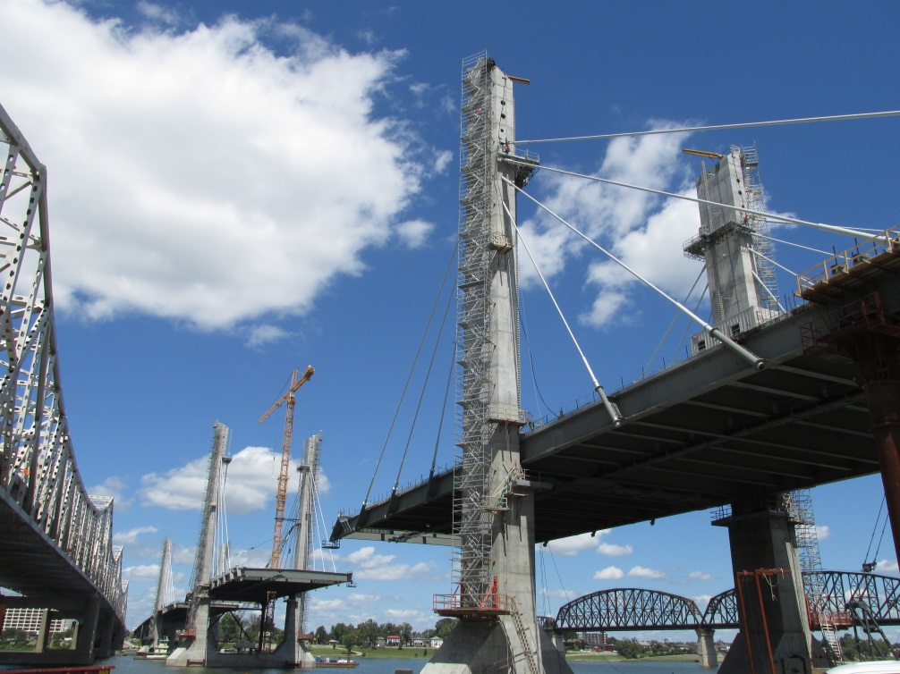
Summary
On budget and on schedule
Design is essentially complete
Construction is 75% complete
Substantial completion in December 2016
Final completion in April 2017

Slide 46
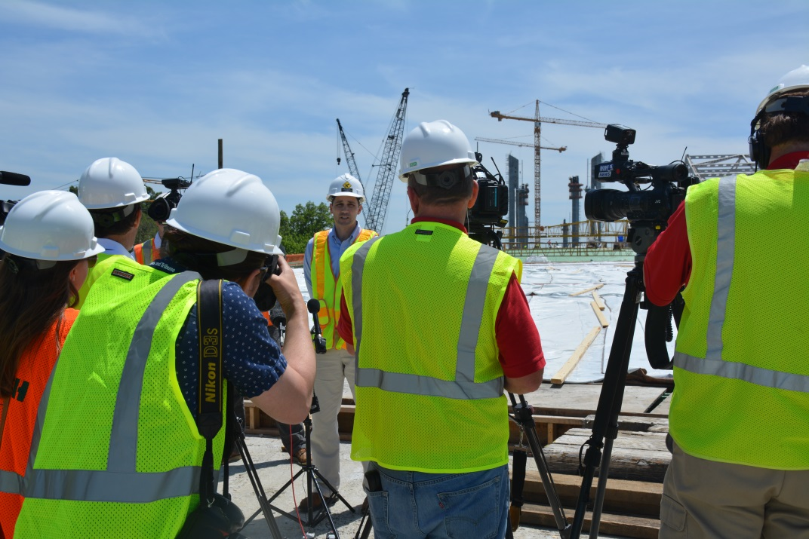
Staying Informed
www.kyinbridges.com
E-blasts and text alerts
Twice-weekly traffic updates
Louisville Downtown Bridge
@LouDntwn Bridge
1-888-ORB-1993
Regular media updates

Slide 47
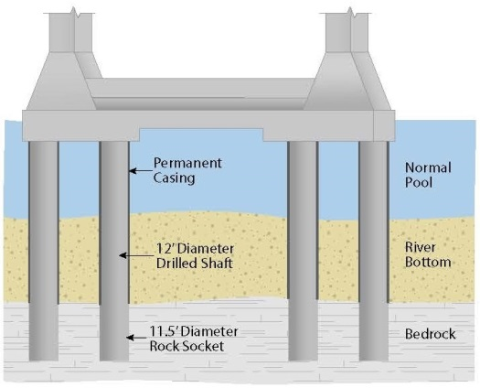
Tower Foundations

Slide 48
12’ Diameter Drilled Shafts (Hain Drilling Machine)

Slide 49
Shaft Repair
Core-drilled a 90” dia. shaft inside 12’ dia. shaft.
Added beam for section loss and overall stiffness.
Over 5,000 shear studs and 170,000 lbs. of plate steel.

Slide 50
Picking and Setting the Beam

Slide 51
World’s Largest Plumb Bob

Slide 52
Tower Anchor Boxes

Slide 53
Wind Fairing

Slide 54
Cable Stayed Bridge Layout
2106 ft
750 ft
750 ft

